Slide 1

CLASSIFICATION OF DATA STRUCTURES
MARTZEL P. BASTE

Slide 2
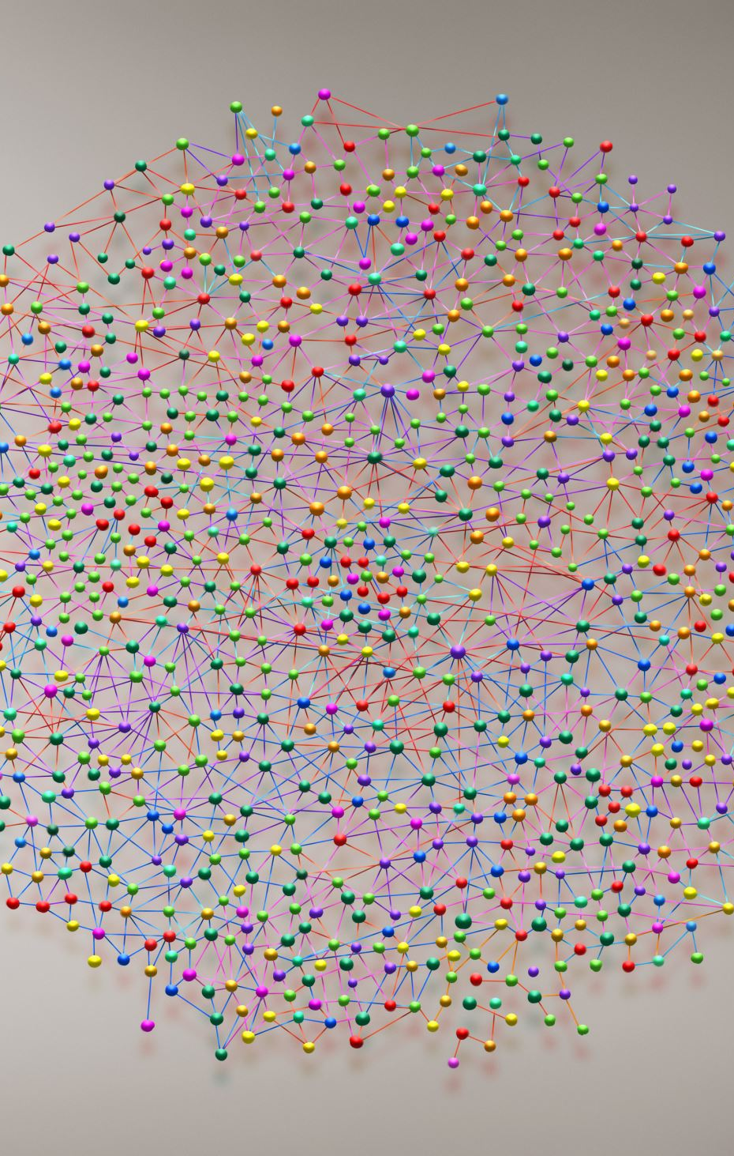
DATA STRUCTURES
Data type
  A collection of values along with a set of operations defined on those values
  Forms
    Simple, scalar, atomic
      Made up of values that cannot be decomposed
    Composite
      Made up of values that can be decomposed
      Also called DATA STRUCTURES!

Slide 3

CLASSIFICATION OF DATA STRUCTURES
Classified by structural relationships between components
Linear data structures
Have 1:1 relationship between elements
Hierarchical data structures
Have 1:many relationship between elements
Graph structures
Have many:many relationship between elements
Set structures
No direct relationship between elements

Slide 4
CLASSIFICATION OF DATA STRUCTURES
Linear
Linear data structures – 1:1
There is FIRST and LAST element
EACH has 1 predecessor and 1 successor
First
Last
Unique
predecessor
Unique
successor

Slide 5
CLASSIFICATION OF DATA STRUCTURES
Hierarchical
Hierarchical data structures – 1:many
EACH element has ONE predecessor and MANY successors
Unique predecessor
Top
Many
successors

Slide 6
CLASSIFICATION OF DATA STRUCTURES
Graph
Graph structures – many:many
Richest and most complex data representations
ANY element can connect or be connected to an ARBITRARY number of other elements in the structure
Many predecessors
Many successors

Slide 7
CLASSIFICATION OF DATA STRUCTURES
Set
Set data structures – 0 relationships
There is ONLY MEMBERSHIP in the set structure
Positioning and location is irrelevant
No predecessors
No successors

Slide 8
There are enormous number and variety of data structures
But they all fall into one of the four fundamental classes of data structures
Each of these four classes will be studied thoroughly
CLASSIFICATION OF DATA STRUCTURES

Slide 9
Arrays
Lists
Ordered Lists
Stacks
Queues
General Lists
Linked Lists
Doubly-linked Lists
ArrayList
Vectors
Heaps And Priority Queues
Circular Buffer
Hash Maps
LINEAR DATA STRUCTURES

Slide 10
HIERARCHICAL
Trees
Binary Trees
Binary Search Trees
Heaps
N-ary Trees
Tries
Directed Acyclic Graphs (DAGs)
many more

Slide 11

Graph
Undirected Graph
Directed Graph (Digraph)
Acyclic and Cyclic Graph

Slide 12

SETS
Union
Intersection
Subset
Superset
HashSet and HashMaps

